Slide 1



Slide 2



01CE1301 – Data Structure
Unit - 4
Sorting & Searching Techniques
Prof. Chirag Bhalodia
Department of Computer Engineering

Slide 3


Outline
Bubble Sort
Selection Sort
Insertion Sort
Merge Sort
Quick Sort
Radix Sort

Slide 4

Bubble Sort

Slide 5
Bubble Sort
Procedure bubble (T[1...n])
for i ← 0 to n-1 do //Decide Number of passes
for j ← 0 to n-i do // Check the index
if T[j] > T[j+1] then // Comparison of elements
T[j] ↔ T[j+1]
end if
end for
end for
Unsorted Array
45 | 34 | 56 | 23 | 12
Pass 1 : i=1
Pass 2 : i=2
Pass 3 : i=3
Pass 4 : i=4
34
34
34
34
23
23
23
45
12
34
swap
34
34
34
swap
swap
34
45
45
12
23
23
23
34
12
34
23
45
45
45
45
swap
swap
12
23
23
34
45
45
56
56
56
12
12
34
23
swap
23
swap
12
12
12
45
23
23
23
45
45
45
56
56
12
swap
12
12
12
12
56
56
56
56
56
56
56

Slide 6
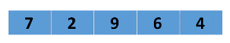
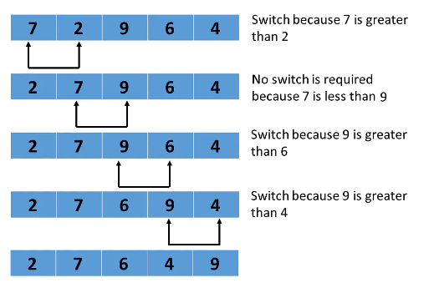
Bubble Sort
Procedure bubble (T[1...n])
for i ← 0 to n-1 do //Decide Number of passes
for j ← 0 to n-i do // Check the index
if T[j] > T[j+1] then // Comparison of elements
T[j] ↔ T[j+1]
end if
end for
end for
First Pass → i=1

Slide 7
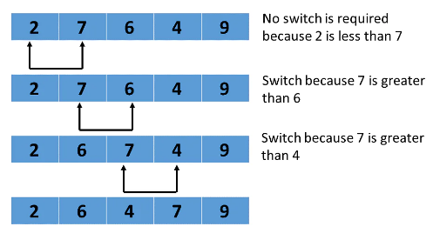
Bubble Sort
Procedure bubble (T[1...n])
for i ← 0 to n-1 do //Decide Number of passes
for j ← 0 to n-i do // Check the index
if T[j] > T[j+1] then // Comparison of elements
T[j] ↔ T[j+1]
end if
end for
end for
Second Pass → i=2

Slide 8
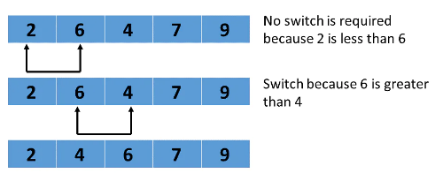
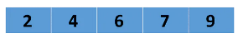
Bubble Sort
Procedure bubble (T[1...n])
for i ← 0 to n-1 do //Decide Number of passes
for j ← 0 to n-i do // Check the index
if T[j] > T[j+1] then // Comparison of elements
T[j] ↔ T[j+1]
end if
end for
end for
Third Pass → i=3
Fourth Pass → i=4

Slide 9
Selection Sort

Slide 10
Selection Sort
Procedure selection (T[1...n])
for i ← 0 to n-1 do
min ← i
for j ← i+1 to n do
if T[j] < T[min] then
min ← j
end if
end for
T[min] ↔ T[i]
end for
Unsorted Array
5 | 1 | 12 | -5 | 16 | 2 | 12 | 14
Assign Index
Unsorted Array
As per given array
Min index = 0, value = 5
5 | 1 | 12 | -5 | 16 | 2 | 12 | 14
0 | 1 | 2 | 3 | 4 | 5 | 6 | 7
Step 1 :
Unsorted Array (elements 0 to 7)
5
-5
1
12
-5
5
16
2
12
14
Find min value from
Unsorted array
Index = 3, value = -5
0
1
2
3
4
5
6
7
Swap

Slide 11
Selection Sort
Procedure selection (T[1...n])
for i ← 0 to n-1 do
min ← i
for j ← i+1 to n do
if T[j] < T[min] then
min ← j
end if
end for
T[min] ↔ T[i]
end for
Step 2 :
As per step -1:
Min index = 1, value = 1
Unsorted Array (elements 1 to 7)
Find min value from
Unsorted array
Index = 1, value = 1
-5
1
1
12
5
16
2
12
14
0
1
2
3
4
5
6
7
No Swapping as min value is already at right place
Step 3 :
Unsorted Array
(elements 2 to 7)
As per step-2:
Min index = 2, value = 12
-5
1
12
2
5
16
2
12
12
14
Find min value from
Unsorted array
Index = 5, value = 2
0
1
2
3
4
5
6
7
Swap

Slide 12
Selection Sort
Procedure selection (T[1...n])
for i ← 0 to n-1 do
min ← i
for j ← i+1 to n do
if T[j] < T[min] then
min ← j
end if
end for
T[min] ↔ T[i]
end for
Step 4 :
Unsorted Array
(elements 3 to 7)
As per step-3:
Min index = 3, value = 5
-5
1
2
5
5
16
12
12
14
Find min value from
Unsorted array
Index = 3, value = 5
0
1
2
3
4
5
6
7
No Swapping as min value is already at right place
Step 5 :
Unsorted Array
(elements 5 to 7)
As per step-4:
Min index = 4, value = 16
-5
1
2
5
16
12
12
16
12
14
Find min value from
Unsorted array
Index = 5, value = 12
0
1
2
3
4
5
6
7
Swap

Slide 13
Selection Sort
Procedure selection (T[1...n])
for i ← 0 to n-1 do
min ← i
for j ← i+1 to n do
if T[j] < T[min] then
min ← j
end if
end for
T[min] ↔ T[i]
end for
Step 6 :
Unsorted Array
(elements 5 to 7)
As per step-5:
Min index = 5, value = 16
-5
1
2
5
12
16
12
12
16
14
Find min value from
Unsorted array
Index = 6, value = 12
0
1
2
3
4
5
6
7
Swap
Step 7 :
Unsorted Array
(elements 6 to 7)
As per step-6:
Min index = 6, value = 16
-5
1
2
5
12
12
16
14
14
16
Find min value from
Unsorted array
Index = 7, value = 14
0
1
2
3
4
5
6
7
Swap

Slide 14
Selection Sort
Procedure selection (T[1...n])
for i ← 0 to n-1 do
min ← i
for j ← i+1 to n do
if T[j] < T[min] then
min ← j
end if
end for
T[min] ↔ T[i]
end for
Step 8 :
As per step -7:
Min index = 7, value = 16
-5
1
2
5
12
12
14
16
0
1
2
3
4
5
6
7
No Swapping as min value is already at right place

Slide 15
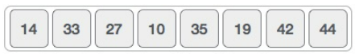
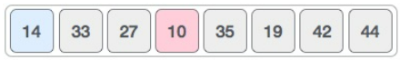
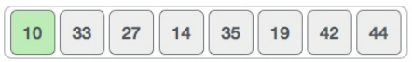
Selection Sort
Procedure selection (T[1...n])
for i ← 0 to n-1 do
min ← i
for j ← i+1 to n do
if T[j] < T[min] then
min ← j
end if
end for
T[min] ↔ T[i]
end for
Unsorted Array
First Pass: i=0, min = 0
min
j

Slide 16
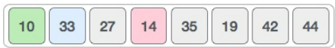
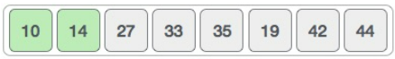
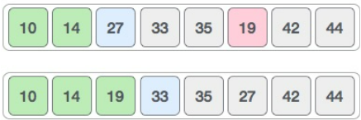
Selection Sort
Procedure selection (T[1...n])
for i ← 0 to n-1 do
min ← i
for j ← i+1 to n do
if T[j] < T[min] then
min ← j
end if
end for
T[min] ↔ T[i]
end for
Second Pass: i=1, min = 1
min
j
Third Pass: i=2, min = 2
min
j

Slide 17
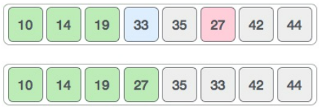
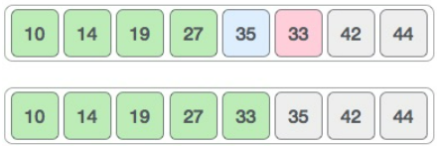
Selection Sort
Procedure selection (T[1...n])
for i ← 0 to n-1 do
min ← i
for j ← i+1 to n do
if T[j] < T[min] then
min ← j
end if
end for
T[min] ↔ T[i]
end for
Fourth Pass: i=3, min = 3
min
j
Fifth Pass: i=4, min = 4
min
j

Slide 18
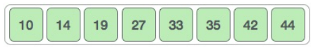
Selection Sort
Procedure selection (T[1...n])
for i ← 0 to n-1 do
min ← i
for j ← i+1 to n do
if T[j] < T[min] then
min ← j
end if
end for
T[min] ↔ T[i]
end for
Sixth Pass: i=5, min = 5
35
Min = j
Seventh Pass: i=6, min = 6
42
Min = j

Slide 19
Selection Sort
Procedure selection (T[1...n])
for i ← 0 to n-1 do
min ← i
for j ← i+1 to n do
if T[j] < T[min] then
min ← j
end if
end for
T[min] ↔ T[i]
end for
Eighth Pass: i=7, min = 7
44
Min = j

Slide 20
Insertion Sort

Slide 21
Insertion Sort
Procedure insertion(T[1...n])
for i ← 1 to n do
curr ← T[i]
j ← i-1
while j >= 0 and T[j] > curr do
T[j+1] ← T[j]
j ← j-1
end while
T[j+1] ← curr;
end for
sorted
sorted
sorted
sorted
sorted
sorted
unsorted
unsorted
unsorted
unsorted
unsorted
unsorted
j
j
j
j
j
j
j
j
j
j
j
6
2
1
5
3
4
6
2
2
1
2
6
6
2
1
1
6
5
5
3
3
4
1
4
1
2
2
6
5
5
3
5
6
6
5
3
3
6
4
1
2
3
5
4
4
6
5
4
6
i
i
i
i
i
i
2
1
5
3
4
curr

Slide 22
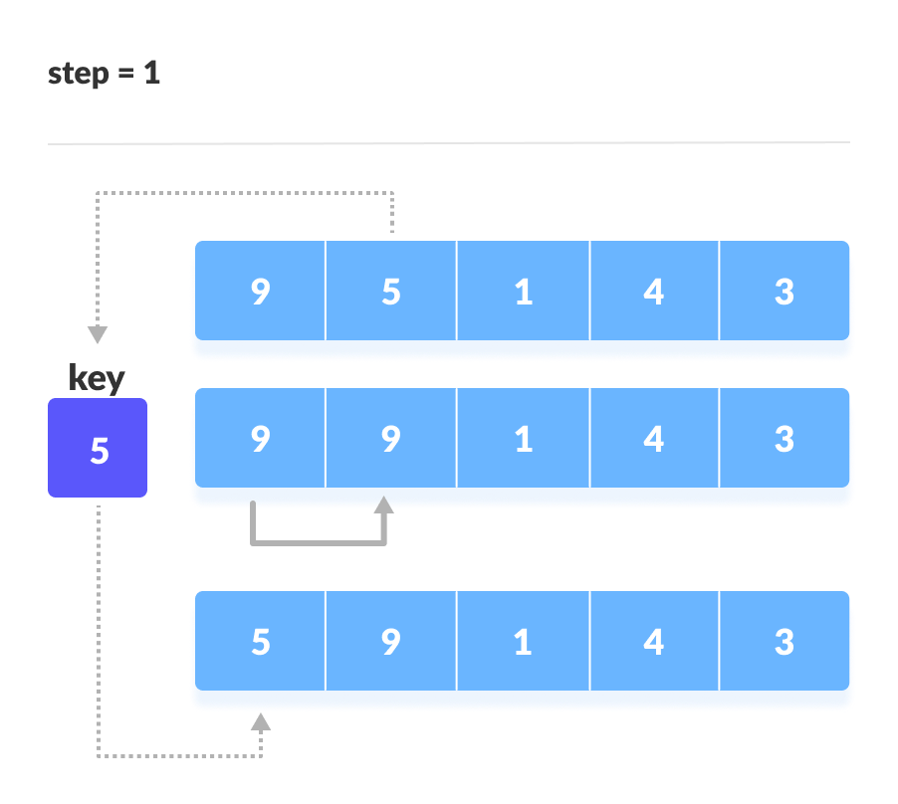
Insertion Sort
Procedure insertion(T[1...n])
for i ← 1 to n do
curr ← T[i]
j ← i-1
while j >= 0 and T[j] > curr do
T[j+1] ← T[j]
j ← j-1
end while
T[j+1] ← curr;
end for

Slide 23
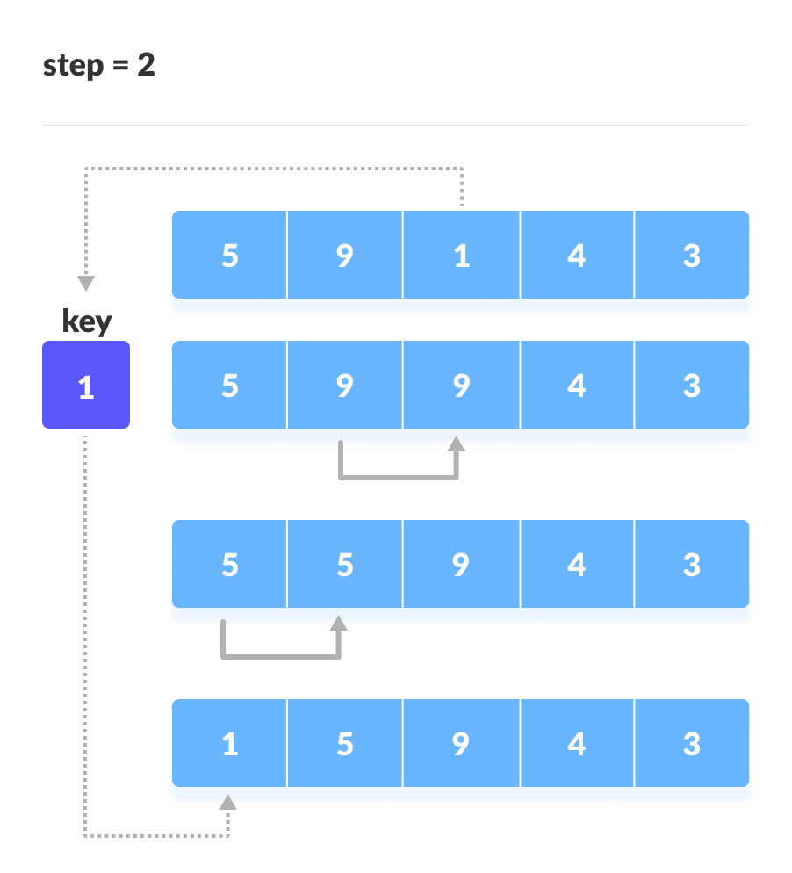
Insertion Sort
Procedure insertion(T[1...n])
for i ← 1 to n do
curr ← T[i]
j ← i-1
while j >= 0 and T[j] > curr do
T[j+1] ← T[j]
j ← j-1
end while
T[j+1] ← curr;
end for

Slide 24

Insertion Sort
Procedure insertion(T[1...n])
for i ← 1 to n do
curr ← T[i]
j ← i-1
while j >= 0 and T[j] > curr do
T[j+1] ← T[j]
j ← j-1
end while
T[j+1] ← curr;
end for

Slide 25
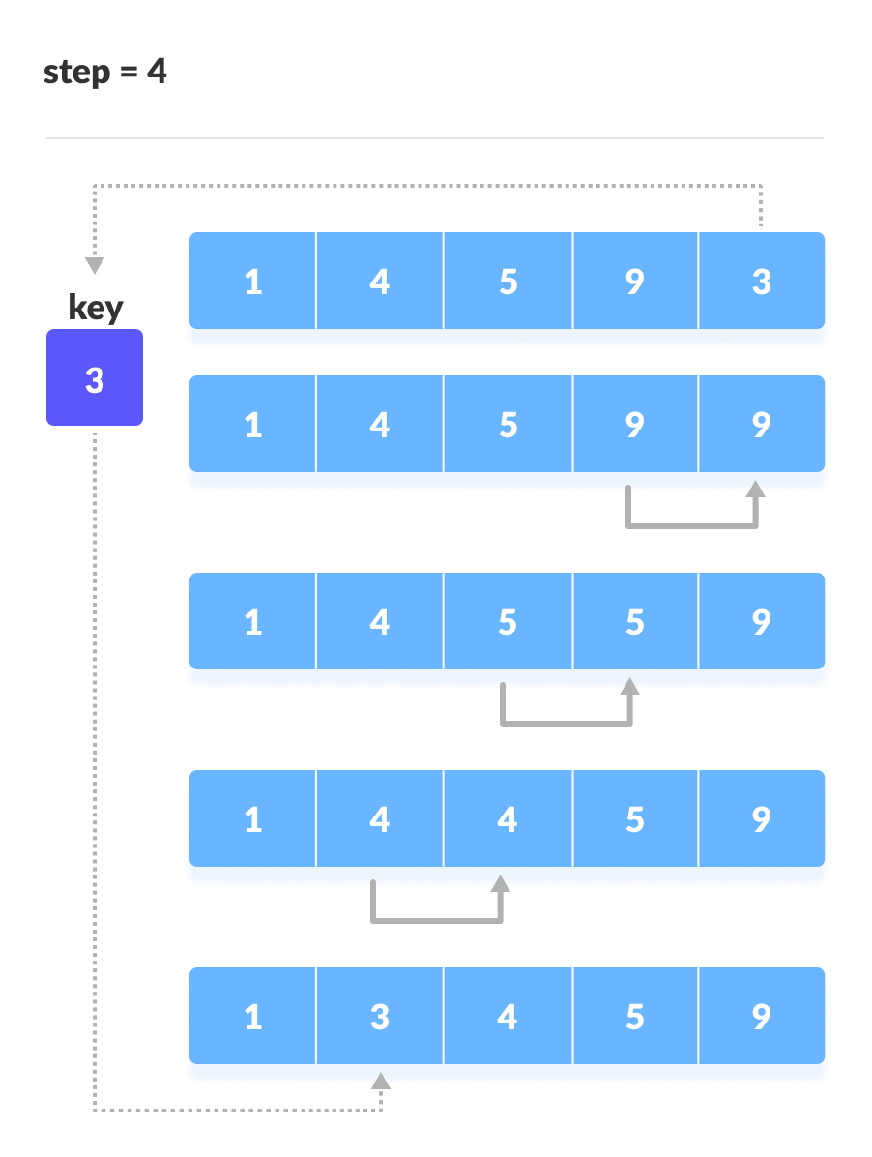
Insertion Sort
Procedure insertion(T[1...n])
for i ← 1 to n do
curr ← T[i]
j ← i-1
while j >= 0 and T[j] > curr do
T[j+1] ← T[j]
j ← j-1
end while
T[j+1] ← curr;
end for

Slide 26
Merge Sort

Slide 27
Merge Sort
15
5
24
8
1
3
16
10
20
15
5
24
8
1
3
16
10
20
15
5
24
8
1
3
16
10
20
15
5
24
8
1
3
16
10
20
15
5
5
15
5
15
24
1
8
3
16
10
20
1
5
8
15
24
3
10
16
20
1
3
5
8
10
15
16
20
24

Slide 28
Merge Sort
MergeSort (A, LB, UB){
If(LB < UB){
mid = (LB+UB)/2;
MergeSort (A, LB, mid);
MergeSort (A, mid+1, UB);
Merge (A, LB, mid, UB);
}
}
Merge(A, LB, mid, UB){
i = LB;
j = mid+1;
k = LB;
while(i <= mid && j <= UB){
if(a[i] <= a[j]){
b[k]=a[i];
i++;
}
else{
b[k]=a[j];
j++;
}
k++;
}
if(i > mid){
while(j <= UB){
b[k]=a[j];
j++;
k++;
}
else{
while(i <= mid){
b[k]=a[i];
i++;
k++;
}
for(k=LB; k<=UB; k++){
a[k]=b[k];
}

Slide 29
Merge Sort
15
5
24
8
1
3
16
10
20
MergeSort (A, LB, UB){
If(LB < UB){
mid = (LB+UB)/2;
MergeSort (A, LB, mid);
MergeSort (A, mid+1, UB);
Merge (A, LB, mid, UB);
}
}
15
5
24
8
1
3
16
10
20
15
5
24
8
1
3
16
10
20
15
5
24
8
1
3
16
10
20
15
5
Merge(A, LB, mid, UB){
i = LB;
j = mid+1;
k = LB;
while(i <= mid && j <= UB){
if(a[i] <= a[j]){
b[k]=a[i];
i++;
}
else{
b[k]=a[j];
j++;
}
k++;
}
if(i > mid){
while(j <= UB){
b[k]=a[j];
j++;
k++;
}
else{
while(i <= mid){
b[k]=a[i];
i++;
k++;
}
for(k=LB; k<=UB; k++){
a[k]=b[k];
}
5
15
5
15
24
1
8
3
16
10
20
1
5
8
15
24
3
10
16
20
1
3
5
8
10
15
16
20
24

Slide 30
ms(0,8)
ms(0,4)
ms(5,8)
merge(0,4,8)
ms(0,2)
ms(3,4)
merge(0,2,4)
ms(0,1)
ms(2,2)
merge(0,1,2)
ms(0,0)
ms(1,1)
merge(0,0,1)
ms(3,3)
ms(4,4)
merge(3,3,4)
ms(5,6)
ms(5,5)
ms(6,6)
merge(5,5,6)
ms(7,8)
ms(7,7)
ms(8,8)
merge(7,7,8)
merge(5,6,8)
Merge Sort
MergeSort (A, LB, UB){
If(LB < UB){
mid = (LB+UB)/2;
MergeSort (A, LB, mid);
MergeSort (A, mid+1, UB);
Merge (A, LB, mid, UB);
}
}
Merge(A, LB, mid, UB){
i = LB;
j = mid+1;
k = LB;
while(i <= mid && j <= UB){
if(a[i] <= a[j]){
b[k]=a[i];
i++;
}
else{
b[k]=a[j];
j++;
}
k++;
}
if(i > mid){
while(j <= UB){
b[k]=a[j];
j++;
k++;
}
else{
while(i <= mid){
b[k]=a[i];
i++;
k++;
}
for(k=LB; k<=UB; k++){
a[k]=b[k];
}

Slide 31
Merge Sort
15
5
24
8
1
3
16
10
20
MergeSort (A, LB, UB){
If(LB < UB){
mid = (LB+UB)/2;
MergeSort (A, LB, mid);
MergeSort (A, mid+1, UB);
Merge (A, LB, mid, UB);
}
}
15
5
24
8
1
3
16
10
20
15
5
5
15
5
15
24
1
8
3
16
10
20
Merge(A, LB, mid, UB){
i = LB;
j = mid+1;
k = LB;
while(i <= mid && j <= UB){
if(a[i] <= a[j]){
b[k]=a[i];
i++;
}
else{
b[k]=a[j];
j++;
}
k++;
}
if(i > mid){
while(j <= UB){
b[k]=a[j];
j++;
k++;
}
else{
while(i <= mid){
b[k]=a[i];
i++;
k++;
}
for(k=LB; k<=UB; k++){
a[k]=b[k];
}
0
1
2
3
4
5
6
7
8
1
5
8
15
24
3
10
16
20
i
j
0
1
2
3
4
5
6
7
8
1
3
5
8
10
15
16
20
24
k

Slide 32
Quick Sort

Slide 33
Quick Sort
QuickSort (A, low, high){
if(low < high){
loc = Partition(A, low, high);
QuickSort (A, low, loc-1);
QuickSort (A, loc+1, high);
}
}
Partition (A, LB, UB){
pivot = low
i = low;
j = high;
while(i < j){
while(A[i] <= A[pivot] && i<high){
i++;
}
while(A[j] > A[pivot] && j>low){
j--;
}
if(i < j){
swap(A[i], A[j]);
}
}
swap(A[pivot], A[j]);
return j;
}

Slide 34
QuickSort (A, low, high){
if(low < high){
loc = Partition(A, low, high);
QuickSort (A, low, loc-1);
QuickSort (A, loc+1, high);
}
}
Quick Sort
low
high
0
1
2
3
4
5
6
7
8
7
6
10
5
9
2
1
15
7
pivot=7
i
i
i
j
0
1
2
3
4
5
6
7
8
7
6
7
5
9
2
1
15
10
Partition (A, LB, UB){
pivot = low
i = low;
j = high;
while(i < j){
while(A[i] <= A[pivot] && i<high){
i++;
}
while(A[j] > A[pivot] && j>low){
j--;
}
if(i < j){
swap(A[i], A[j]);
}
}
swap(A[pivot], A[j]);
return j;
}
i
i
i
j
j
j
0
1
2
3
4
5
6
7
8
7
6
7
5
1
2
9
15
10
i
j
i
j
i
i
0
1
2
3
4
5
6
7
8
2
6
7
5
1
7
9
15
10
j
i

Slide 35
QuickSort (A, low, high){
if(low < high){
loc = Partition(A, low, high);
QuickSort (A, low, loc-1);
QuickSort (A, loc+1, high);
}
}
Quick Sort
low
high = L - 1
0
1
2
3
4
5
6
7
8
2
6
7
5
1
7
9
15
10
pivot=2
i
i
j
0
1
2
3
4
5
6
7
8
2
1
7
5
6
7
9
15
10
Partition (A, LB, UB){
pivot = low
i = low;
j = high;
while(i < j){
while(A[i] <= A[pivot] && i<high){
i++;
}
while(A[j] > A[pivot] && j>low){
j--;
}
if(i < j){
swap(A[i], A[j]);
}
}
swap(A[pivot], A[j]);
return j;
}
j
j
i
i
j
j
i
low = L + 1
high
0
1
2
3
4
5
6
7
8
1
2
7
5
6
7
9
15
10
pivot=7
i
i
i
j
low =
L + 1
high
4
7
0
1
2
3
5
6
8
1
2
6
5
7
7
9
15
10
pivot=6
i
i
j
0
1
2
3
4
5
6
7
8
1
2
5
6
7
7
9
15
10

Slide 36
QuickSort (A, low, high){
if(low < high){
loc = Partition(A, low, high);
QuickSort (A, low, loc-1);
QuickSort (A, loc+1, high);
}
}
Quick Sort
low = L + 1
high
0
1
2
3
4
5
6
7
8
1
2
5
6
7
7
9
15
10
pivot=9
j
i
i
j
j
low =
L + 1
high
Partition (A, LB, UB){
pivot = low
i = low;
j = high;
while(i < j){
while(A[i] <= A[pivot] && i<high){
i++;
}
while(A[j] > A[pivot] && j>low){
j--;
}
if(i < j){
swap(A[i], A[j]);
}
}
swap(A[pivot], A[j]);
return j;
}
0
1
2
3
4
5
6
7
8
1
2
5
6
7
7
9
15
10
pivot=15
i
i
j
0
1
2
3
4
5
6
7
8
1
2
5
6
7
7
9
10
15

Slide 37
Linear Search

Slide 38
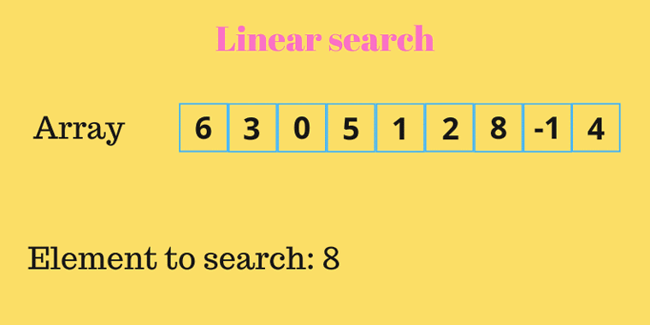
Linear Search
Linear search in C to find whether a number is present in an array. If it's present, then at what location it occurs. It is also known as a sequential search.
we compare each element with the element to search until we find it or the list ends.

Slide 39
Linear Search
for(i=0; i<n; i++)
{
if(a[i] == data)
{
Printf(“element found at location: %d”, i);
Break;
}
}
If(i == n){
printf(“element not found”);
}

Slide 40
Binary Search

Slide 41
Binary Search
Binary search will take less time than linear search.
Precondition: Array must be sorted. If array is not sorted we cannot apply algorithm.
Working Principle:
Search a sorted array by repeatedly dividing the search interval in half.
We basically ignore half of the elements just after one comparison.
Compare data with the middle element.
If data matches with middle element, we return the mid index.
Else If data > mid element, then data can only lie in right half subarray after the mid element. So we trace for right half.
Else (data is smaller) trace for the left half.

Slide 42
Binary Search
BINARY-SEARCH(A, low, high, data){
if(low <= high){
mid = floor((start + end)/2)
if (A[mid]== data){
return mid
}
if (A[mid]>data){
return BINARY-SEARCH(A, low, mid-1, data)
}
if( A[mid]<data){
return BINARY-SEARCH(A, mid+1, high, data)
}
return FALSE // in case, element is not in the array
}

Slide 43
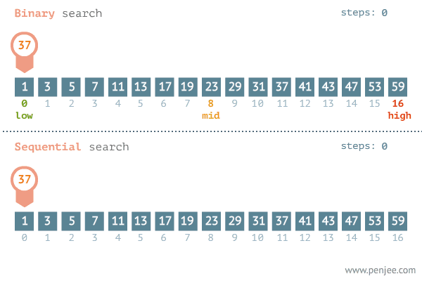
Binary Search vs Linear Search

Slide 44

Thank
You

